Slide 1
Oliver McInroy & Co.
Makers of Lighting, Accent Furniture, Wall Décor and Accessories

Slide 2
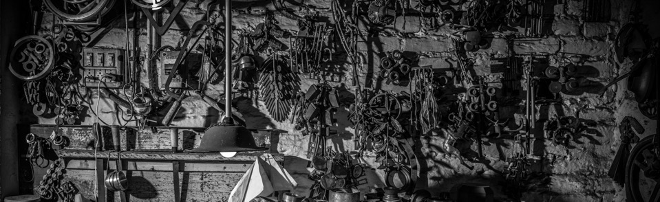
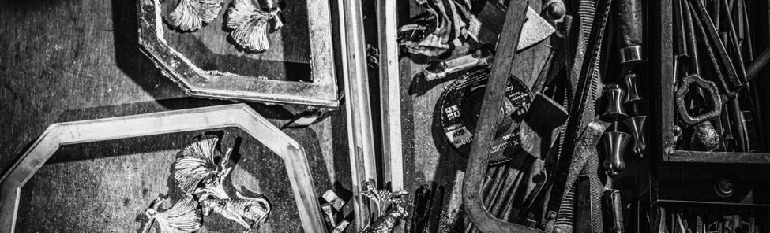
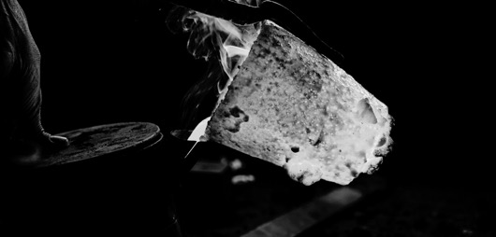
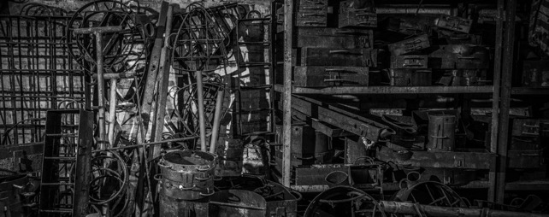
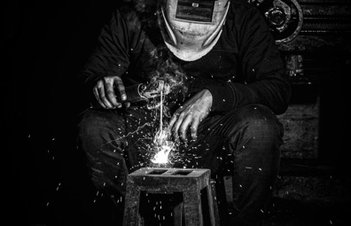
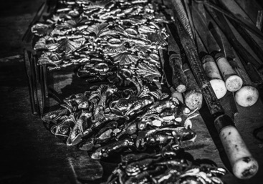
Oliver McInroy & Co.
ABOUT US
Oliver McInroy was established in 1992 as a handcrafted metal home décor manufacturer. Working with equal ease in most metals like Brass, Aluminum, Stainless steel, and Iron. Lighting, Accent Furniture, Wall Pieces, Decorative Hardware, and Sculptures. Our business is run by two business partners who have 3-decades experience in this field. We have two large factories having about a 100000sq ft covered area in the city of Moradabad.

Slide 3
Oliver McInroy & Co.
2
450+
100,000
FACTORIES
EMPLOYEES
SQ FT
5+
200+
200,000
PRODUCTION
LINES
CONTAINER CAPACITY
ANNUAL UNITS

Slide 5
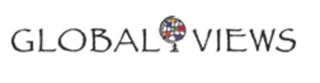


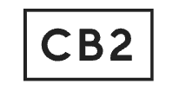
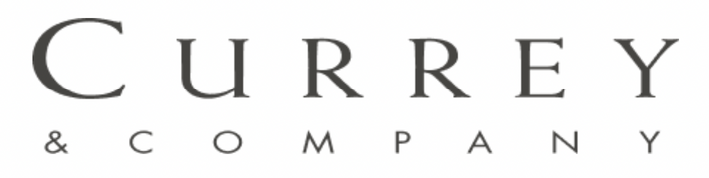
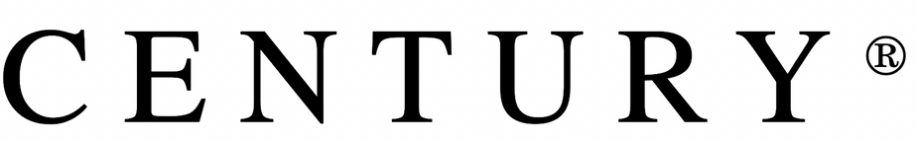


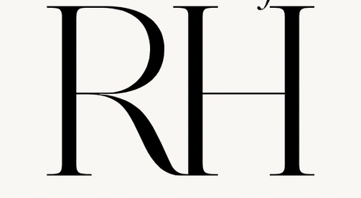
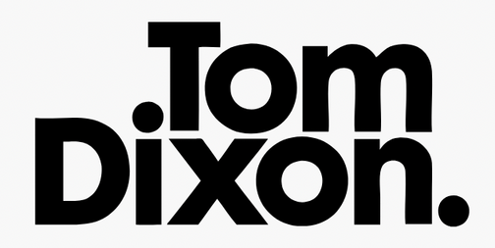
Oliver McInroy & Co.
OUR CLIENTS

Slide 6

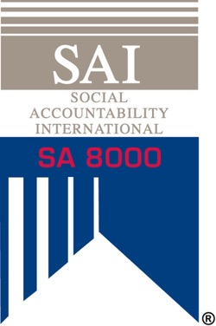


Oliver McInroy & Co.
CERTIFICATIONS

